Slide 1
MyCo Configurations
By: Team 2

Slide 2
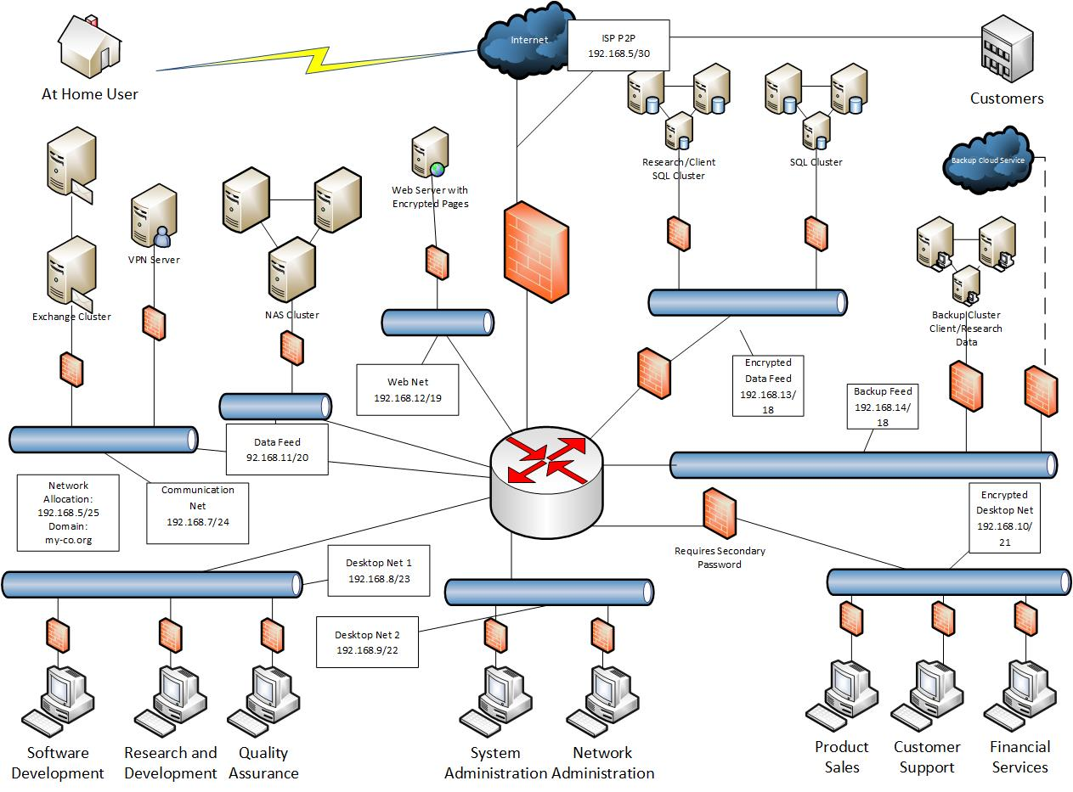
Architecture

Slide 3

Server
OS: Windows Server 2012 R2
Processor: 2 Intel® Xeon® E5-2600 v3 Series processors
Memory: Up to 768 gb via 24 slots (UDIMM/RDIMM/LRDIMM/HyperCloud DIMM)
Max Storage: Up to 25.6 TB (2.5-inch model) or 24 TB (3.5-inch model) SAS/SATA
Price: $1,550.00

Slide 4
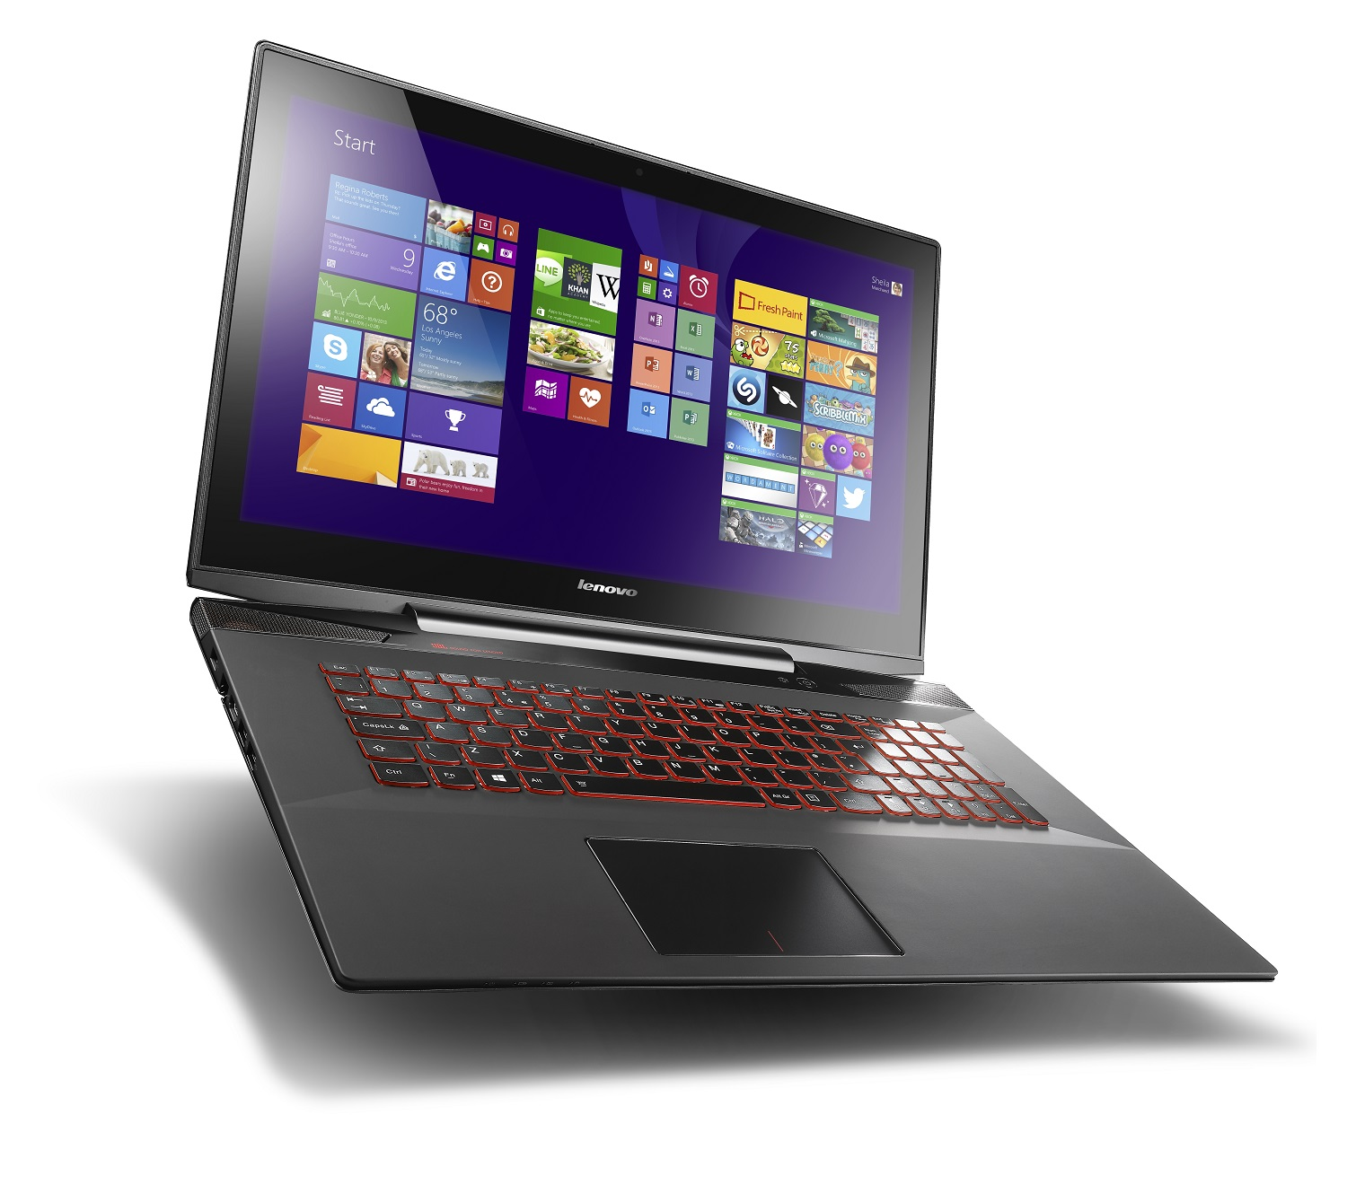
Workstation
OS: Windows 10 Enterprise 64-bit/Ubuntu 14.04.4 LTS (Dual Boot)
Processor: Intel Core i5-6400 Processor
Memory: 8GB DDR4 2133MHz UDIMM
Storage: 500GB Hard Drive,7200 RPM, 3.5", SATA
Price: $853.58

Slide 5

Software
Windows 10 Enterprise
Office 2016/Outlook
Skype
TeamViewer
Symantec Endpoint
Total Cost: $767.72/flat cost + $2,799/year + $10.50/month

Slide 6
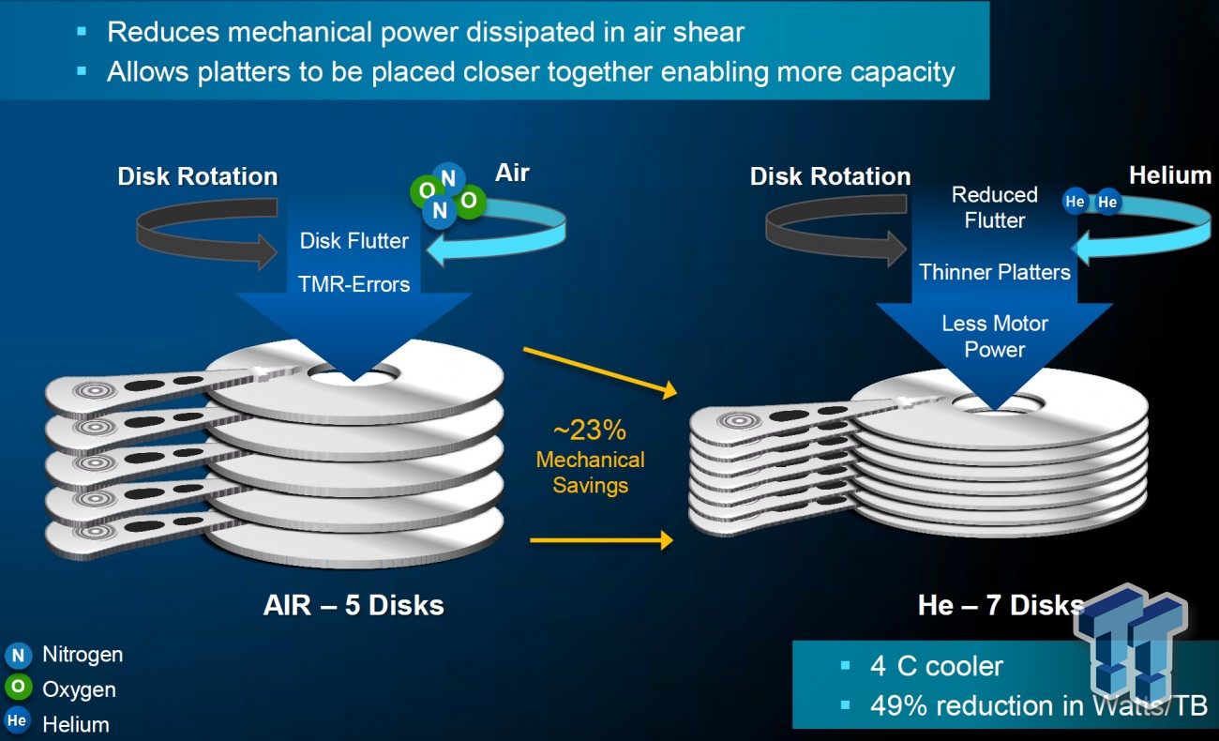
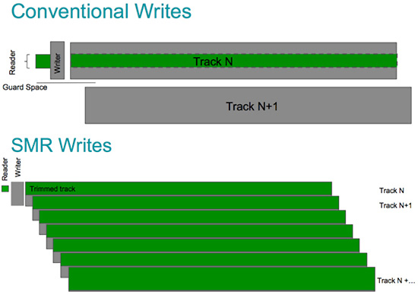
Future Hardware Upgrades
Helium Hard Drives
SMR Hard Drives

